Slide 1
Big Data Analytics (with SPARK)
2019.8.27
Sung Hoon Lim
600005/01

Slide 2
Class Logistics

Slide 3
Welcome!
Instructor: Sung Hoon Lim (임성훈)
Office: SW (공학관) 1242
Email: shlim@hallym.ac.kr
Office hours: Tuesdays after class or by appointment
Class: 1101A, 1116-1, Tues. Thurs. 3, 4
TA: 이진우
Office: 1314
Email: sempre813@naver.com
Webpage: Github xxx, smart campus

Slide 4
Class Information
English class
References and class notes will be in English
Syllabus will be modified with feedback

Slide 5
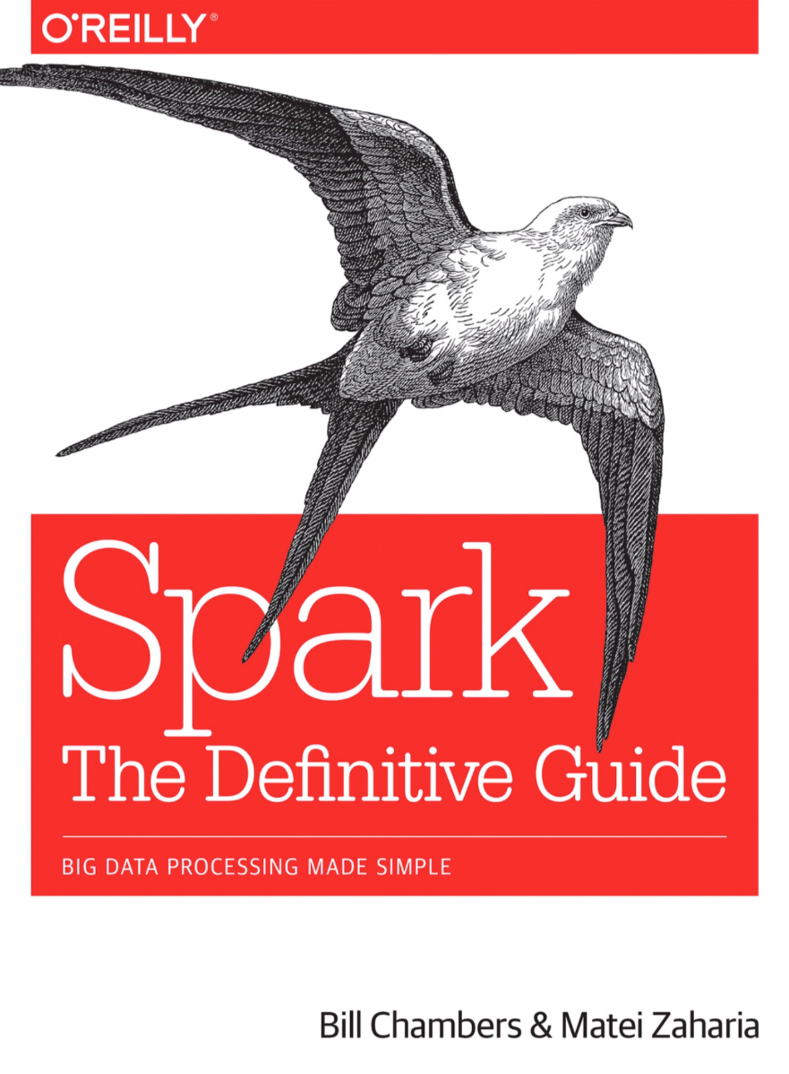
Textbooks
No Official Textbooks
Main Reference: Spark the definitive guide, Bill Chambers, O’Reilly
References:
Python for Data Analysis, by McKinney, from O'Reilly
Data Science from scratch, Joel Grus, O’Reilly
…

Slide 6

Course Prerequisite
Python Programming! or SCALA

Slide 7
This course is not for you…
If you do not have a python programming background
This course is not about only programming
Focus on how to manage and process Big Data
No previous experience necessary in
SPARK
MapReduce
Parallel and distributed programming

Slide 8
Grade Scheme
Homework | 15%
Project Class Participation Midterm Final | 20% 10% 20% 35%
Zero-Tolerance on plagiarism

Slide 9
Course structure
Each week we will have
2 hour lecture
2 hour Lab
Lecture will be instructed with slides
Lab will be instructed by our class TA and instructor
Lab will be structured by the instructor and TA jointly
Mostly will be given tasks from lecture using ”notebooks”
Some LAB assignments will be given as homework

Slide 10
Project
Project (due xxx)
One project: Group size <= 3 students
Checkpoints
Proposal: title and goal (due xxx)
Outline of approach (due xxx)
Implementation and Demo (due xxx)
Final Project Report (due xxx)
Each group will have a short presentation and demo (15-20 minutes)
Each group will provide a five-page document on the project; the responsibility and work of each student shall be described precisely

Slide 11
What will you learn in this class?

Slide 12


Big Data
What is Big Data?
Data that is too large or too complex to be managed using traditional data processing, analysis, and storage techniques
Notes:
Enter Big Data. A common definition of Big Data is “data that is too large or too complex to be managed using traditional data processing, analysis, and storage techniques.”

Slide 13
Volume: Scale of data
90% of today’s data has been created in just the last 2 years
40 zettabytes (40 trillion gigabytes) of data will be created by
2020, an increase of 300 times from 2005
Equivalent of 5,200 gigabytes of data for every man, woman and child on Earth
Most companies in the US have over 100 terabytes (100,000 gigabytes) of data stored
Notes:
A few examples of the volume of data we are amassing…
The number are truly mind-boggling.
https://www.emc.com/leadership/digital-universe/2014iview/index.htm
http://www.infodocket.com/2014/04/16/how-large-is-the-digital-universe-how-fast-is-it-growing-2014-emc-digital-universe-study-now-available

Slide 14
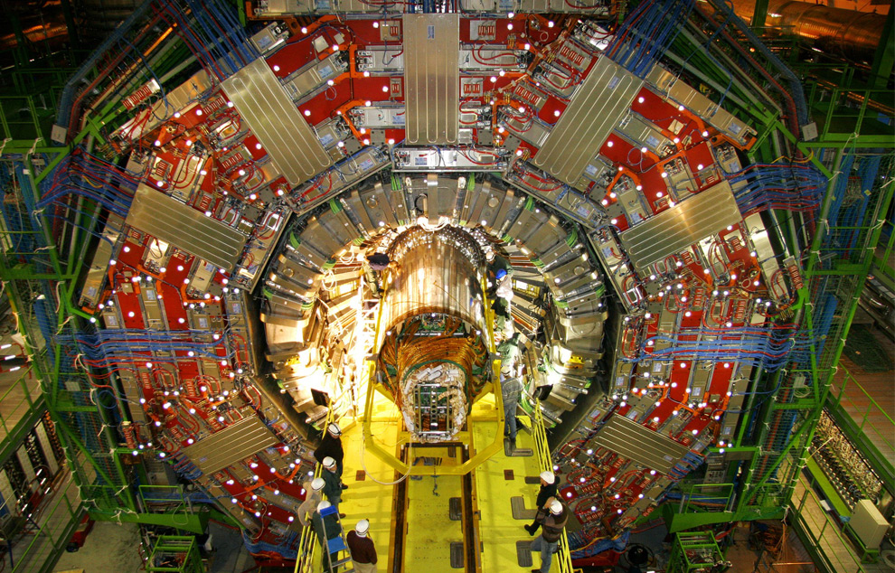
CERN’s Large Hadron Collider (LHC) generates 15 PB a year
Maximilien Brice, © CERN

Slide 15
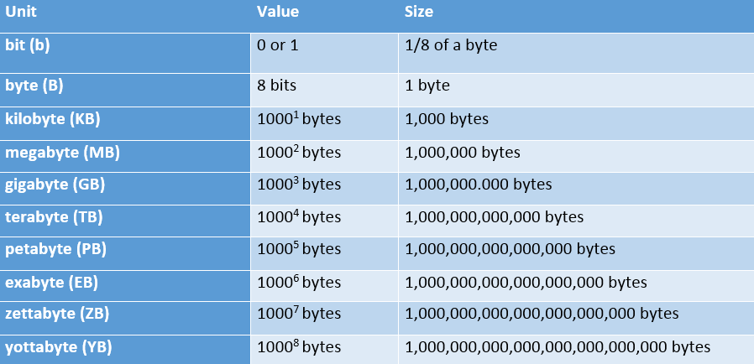

Volume: Scale of data
Notes:
We’re all pretty familiar with file sizes in the kilobyte, megabyte, and gigabyte range. When it comes to Big Data, data files can exceed those numbers by several orders of magnitude. Data collections are so larger that they require special storage and analysis options. Enter Hadoop, an open-source software framework for storage and processing of big data sets. One of the creators, Doug Cutting, named it after his 2 year old son’s stuffed elephant.

Slide 16














Variety: different forms of data
Structured data vs. unstructured data
Notes:
A good way to visualize the variety of Big Data available is to think of social media sites. When we think about varieties of data, it is helpful to also think of it as either structured or unstructured. Structured data is the kind of data we find in a fixed field in a record, file, or spreadsheet. Unstructured data refers to data that doesn’t follow a specific format. Think satellite images, photographs and video, social media data, and medical records.

Slide 17
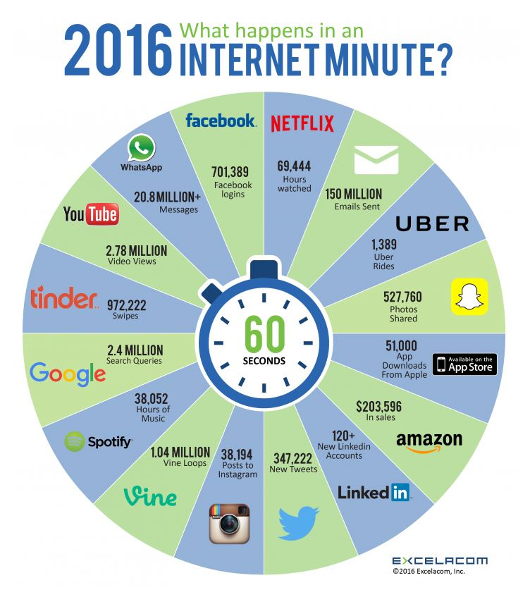
What happens in an Internet minute?
Notes:
Excela, Incorporated’s infographic demonstrates how much data was created in just one Internet minute in 2016…

Slide 18
The Goal of Data Analytics: From Data to “Knowledge” or Action
Pattern detection:
Raw data → patterns → partial understanding
“Show me sales by region by product category”
“Show me clusters of documents by concept”
Given an observation:
Hypothesis → experiment over sample → significance
Do statistical test, measure significance vs. null hypothesis
Collect → Extrapolate → Recognize → Build → Apply
Notes:
We’re gonna recite it. It’s gonna be awesome.
Up next: CERBA in this course

Slide 19

Super computers
Cray, Deep Blue, Blue Gene, 천둥…
Specialize hardware
Extremely expensive
Specialized important problems
“Summit”: 200 petaflops/sec
Oak Ridge National Lab.

Slide 20

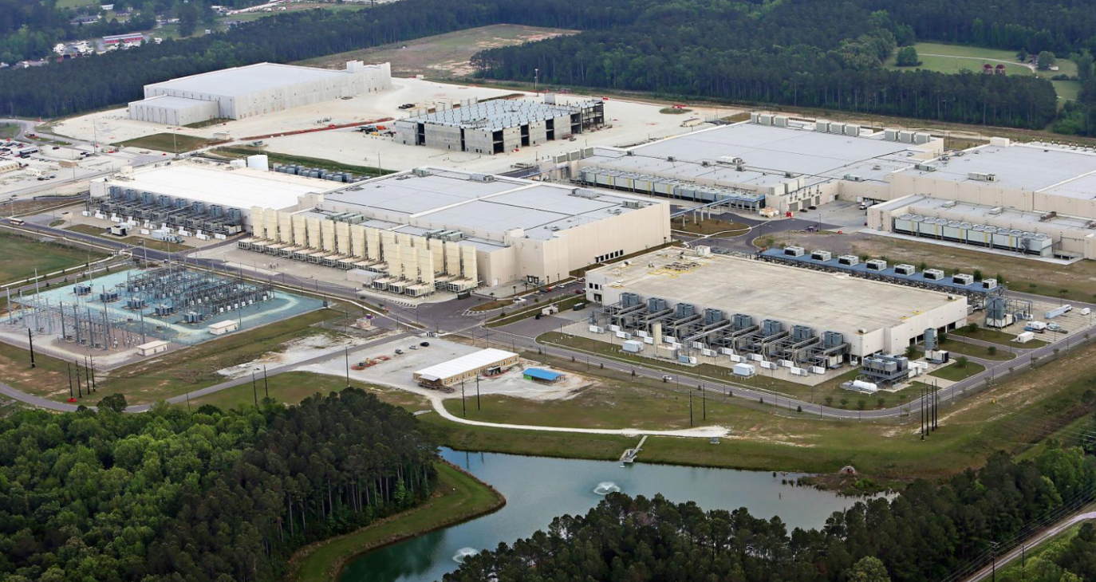
Data Centers (Clusters)

Slide 21
Data Centers (Clusters)
The physical aspect of “the cloud”
Collection of commodity computers
Vast number of computer (100,000’s)
Created to provide computation for large and small organizations
Computation as a commodity

Slide 22
The Big Data Problem
End of Moore’s Law around 2005
Cost of storage and data collection is still decreasing
Processing requires large, parallel computations, often on clusters of machines
Requires new programming models

Slide 23
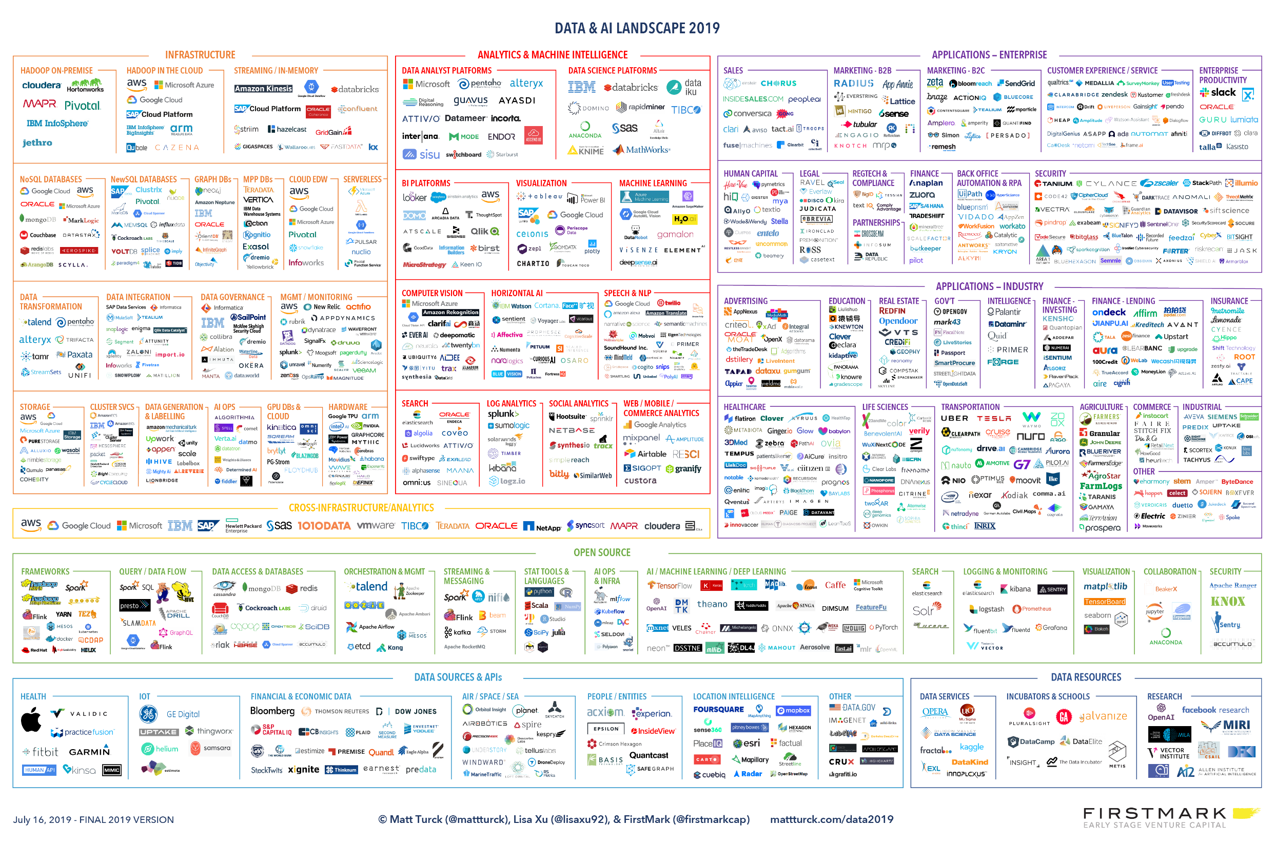

Slide 24
Making History: Google 2003
Larry Page and Sergey Brin developed a method for storing very large files on multiple commodity computers
Each file is broken into fixed-size chunks
Each chunk is stored on multiple chunk servers
The locations of the chunks is managed by the master

Slide 25
Hadoop File System (HDFS)
Commodity Hardware: Low cost per byte of storage
Locality: Data stored close to CPU
Redundancy: Can recover from server failures
Simple abstraction: Looks to user like standard file system (files, directories, etc.) Chunk mechanism is hidden

Slide 26
Map-Reduce
HDFS is a storage abstraction
Map-Reduce is a computation abstraction (in pair with HDFS)
Allows programmers to specify parallel computation without knowing how the hardware is organized
We will describe Map-Reduce, using Spark, in later lectures

Slide 27
Spark
Developed by Matei Zaharia, AMPlab UC Berkeley, 2009
Spark: Managing and coordinating the execution of tasks on data across a cluster of computers
Hadoop uses shared file system (disk)
Spark uses shared memory – faster, lower latency
Will be used in this course

Slide 28
Topics
Scope: Big Data & Analytics
Topics:
Introduction to Big data architectures
Python + libraries (pyspark)
SPARK/Map-Reduce Programming
Machine learning on big data architectures

